Slide 1
WELCOME
Changing Destructive
Adolescent Behavior

Slide 2
Unit 2
Addressing Problematic Behavior

Slide 3
Unit Two: Objectives
Parents will be able to:
Recognize the signs of trauma
Discuss successful methods to end family arguments
List 5 tips to consider before confronting problematic behavior
Practice effective confrontation

Slide 4
Before We Begin
Elect Group Roles:
Group Facilitator
Group Timekeeper
Group Reporter
Group Nurturers/Cheerleader(s)

Slide 5
The Most Effective Methods of Influencing and Motivating Children:
Positive Strokes
Positive Consequences
Negative Consequences

Slide 6
Focusing Activity 2.1
Example: Angry!
Example: I’m just not good enough.

Slide 7
Traumatic Events
Unstable / unsafe home
High crime area
Losses / death of friends / family
Separation / divorces
Serious illness
Major changes (moving, attending a new school)
Sexual, physical or verbal abuse
Domestic violence
Media violence
Bullying, threats from peers
Seeing someone violently attacked / killed
Vehicle accident
Physical injury
Suicide of friend, neighbor or relative

Slide 8
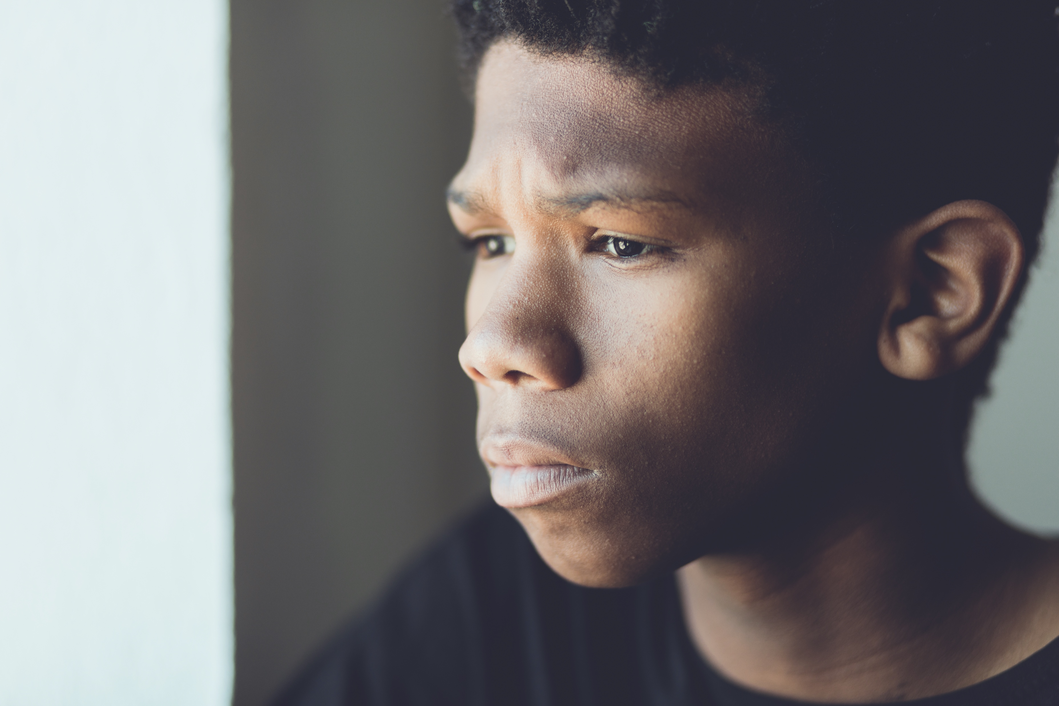
Group Activity 2.2
SIGNS OF TRAUMA
Working alone, with your spouse, or significant other, review the list of signs and symptoms of trauma. Circle the ones that may describe your child.

Slide 9
Parents Should
Daily displays of love and affection
Do not scream or yell at your child
Try not to argue with your child
Do not use sarcasm or ridicule
Actively supervise daily activities
Supervise your child’s exposure to violence (YouTube, TV, movies, internet, & video games, etc.)
Help you child structure their day with positive, productive activities.
Focus on the future – avoid dwelling on the past

Slide 10
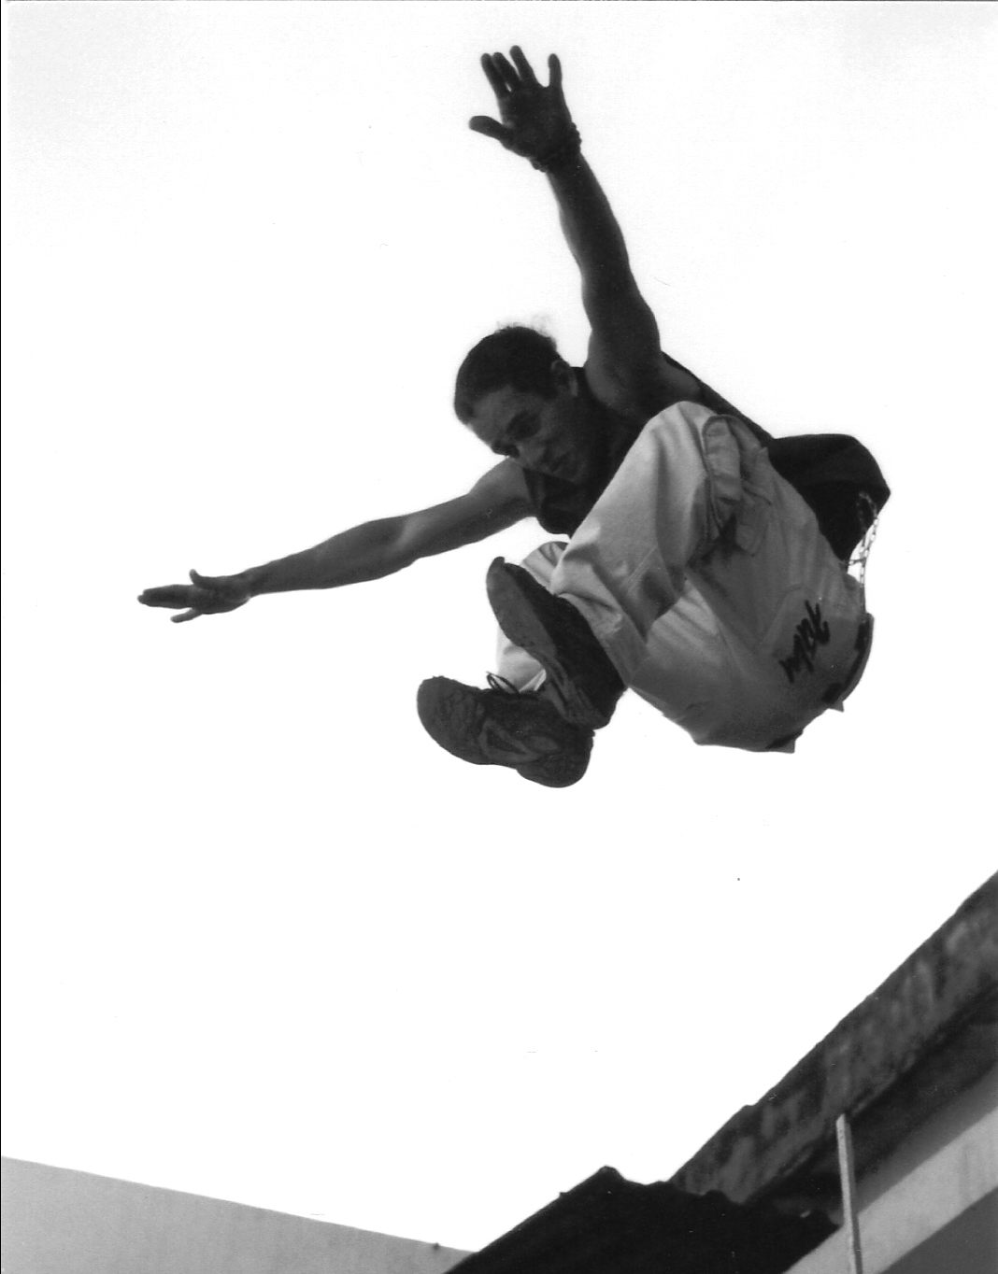
Kids Think Differently!
Knowing they had already been discovered, the boys jumped anyway!

Slide 11
Group Activity 2.3: Kids
Children usually
Children generally
Children usually
Children are more likely to
Children respond

Slide 12
Yelling at our children will not rush brain development!

Slide 13
Screaming and Yelling

Slide 14
If you do not want to argue with your children and teenagers…
…Don’t!
If one won’t, then two can’t

Slide 15
“Nevertheless…”
“Regardless…“
Your new best friends!

Slide 16
If one won’t, then two can’t
…Argue

Slide 17
Focus on the T.O.P.I.C.
Timing
Develop a plan or an Outline
Pick a private, neutral location
Minimize Interruptions
Consider and prepare for the worst

Slide 18
Group Activity 2.5(a) Focus on the “TOPIC”
1. Timing
2. Develop a plan/Outline
3. Choose a Private / neutral location
4. Minimize Interruptions
5. Consider the worst

Slide 19
Outline your conversation
I LOVE YOU…
I SEE (describe the behavior)
I FEEL (describe your feelings)
LISTEN (Shhh! Just listen)
I WANT (state the rule)
I WILL (state what you will do)

Slide 20
Never miss a good chance to Shut Up!

Slide 21
What to expect:
Anger
Denial
Blaming
Bluffing
Avoid:
Insisting your child look at you
Apologizing for the confrontation
Judging the child
Preaching or lecturing
Ridiculing the child
Trying to scare the child
Comparing the child to others
Lying to the child
Using sarcasm
Do:
Remain calm
Stay on track
Clarify rules
Clarify expectations/ consequences
End on a positive note

Slide 22
Group Activity 2.5(b)
I Love:
I See:
I Feel:
Listen:
I Want:
I Will:

Slide 23
Threats of Running Away
Do not:
challenge your child to run
Do:
try & defuse the situation

Slide 24
Threats of Suicide
Do not:
challenge your child
take the threat lightly
Do:
call a mental health professional
call the police
try to defuse the situation
err on behalf of your child’s safety

Slide 25
Warning Signs of Suicide
Low self-esteem
Exaggerated view of problems
Lack of direction
Severe reaction to loss of friend
Personality & behavior changes
Previous attempts
Changes in sleeping habits
Changes in eating habits
Sudden unexplained improvement
Destructive behaviors: reckless driving,
drug/alcohol use eating disorders, etc.
Making final arrangements, giving away
prized possessions, etc.

Slide 26
Group Activity 2.6 What else?

Slide 27
Review Activity 2.7
Children are generally driven by________ .
Parents should __________ themselves before they address problematic behaviors with their children.
Parents should always be calm when they ________ their children about problematic behaviors.
Parents should develop a ________ or an __________ before addressing problematic behavior.
When a child threatens suicide, parents should call a mental health professional or the police ______________.
outline / confront / emotion / immediately / plan / prepare

Slide 28
Review Activity 2.7
Most powerful ideas YOU learned:

Slide 29
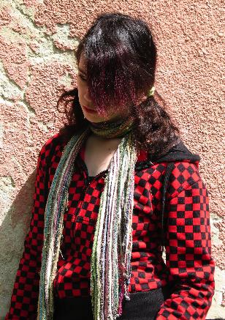
Critical Family Concept:
My kids need
positive strokes.

