Slide 1

WELCOME
Preparing Our Kids for Success

Slide 2

Session Objectives:
Parents will be able to:
Describe their dreams and wishes for their children
Recognize the necessity of creating structure for children
Identify strategies for getting kids to school
Discuss successful methods of increasing home/school communication
List strategies for improving school performance
Implement the Homework Assignment Sheet

Slide 3
Before We Begin
What is your partner’s name?
What are the names and ages of your partner’s children?
What does your partner hope to learn from this class?

Slide 4
The Facts
1.2 million students dropout every year
Truancy #1 predictor of delinquency (U.S. Department of Justice)
9th grade attendance is a better predictor of graduation than 8th grade test scores
Missing just 10% (18 days of school) drastically affects academic performance.
Regular school attendance: an important life skill that builds self-esteem, self-discipline and achievement

Slide 5
Group Roles
Group Facilitator
Group Recorder / Reporter
Group Timekeeper
Group Cheerleaders

Slide 6
Activity 1.1 Roles
Group Facilitator
Group Recorder / Reporter
Group Timekeeper
Group Cheerleaders

Slide 7

Group Activity 1.2: When Kids Fail
Examples:
Drug use
Criminal Activity

Slide 8
Activity 1.3 Goals
Examples:
Good job
Good relationships

Slide 9
Traumatic Events
Unstable / unsafe home
High crime area
Losses / death of friends / family
Separation / divorces
Serious illness
Major changes (moving, attending a new school)
Sexual, physical or verbal abuse
Domestic violence
Media violence
Bullying, threats from peers
Seeing someone violently attacked / killed
Vehicle accident
Physical injury
Suicide of friend, neighbor or relative

Slide 10

Group Activity 1.4: Signs of Trauma

Slide 11
What can we do?
Daily Love and Affection (Hugs, Kisses)
Don’t scream at your children
Don’t argue with your kids
Don’t ridicule or use sarcasm
Actively supervise daily activities
Actively supervise media use (TV, video games, internet, mobile apps, etc.)
Structure your child’s day with productive activities (school, sports, school-based clubs, exercise, etc.)
Focus on the present and future. Don’t dwell on past events.

Slide 12
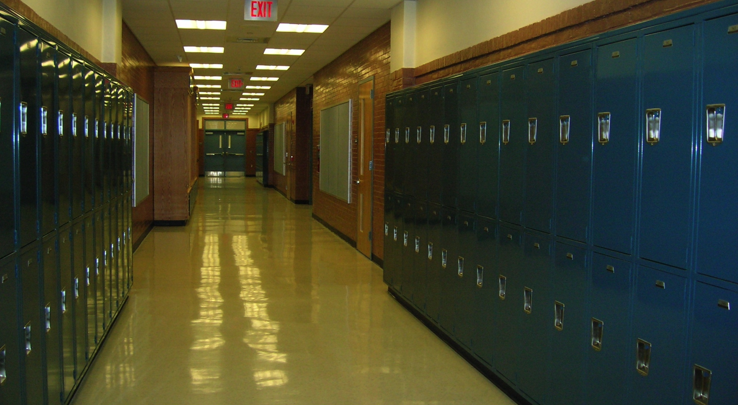
Getting Back to School
A journey of 1,000 miles begins with the first step.

Slide 13
Teens need more sleep than adults!
Parents must take control of:
Smart Phones
Video game controllers
Music players
Computers
and all other electronics at bedtime.

Slide 14
Self-Discipline
Type I
The ability to stop yourself from doing the wrong thing.
Type II
The ability to do constructive tasks on your own (go to school, do homework, do chores, etc.).

Slide 15

Well structured days may include time for:
Family
Friends
Chores
Free time
Prayer
School
Sports
Homework

Slide 16
Group Activity 1.5: Lists
Child’s List
“Motivators”
video games
text friends
Parent’s List “Responsibilities”
go to school
do homework

Slide 17
“Take as much time as you need.”
(a powerful statement!)

Slide 18
Never get into a struggle or “tug of war” over the things to be removed.

Slide 19
Group Activity 1.6:
Words That Work

Slide 20
Parents need three things to help children improve their grades
Use the online system or have the child complete a Homework Assignment Sheet
Approve the homework when it is finished & acknowledge success
Control the things on the “Child’s List” (see Activity 1.5) until the homework is finished and has been approved by a parent.

Slide 21
Daily Homework Assignment Sheet

Slide 22
Group Activity 1.7: Problems

Slide 23
Group Activity 1.8: Finding Ways

Slide 24
Accountability + Motivation
= Change

Slide 25
Group Activity 1.9: Excuses, Excuses
Excuse/Reason
5.
6.
7.
8.
9.
10.
Consequence

Slide 26

Parents control things, not children

Slide 27
We change when we are tired of the way things are!

Slide 28
How long can your child go without the things on their list?

Slide 29
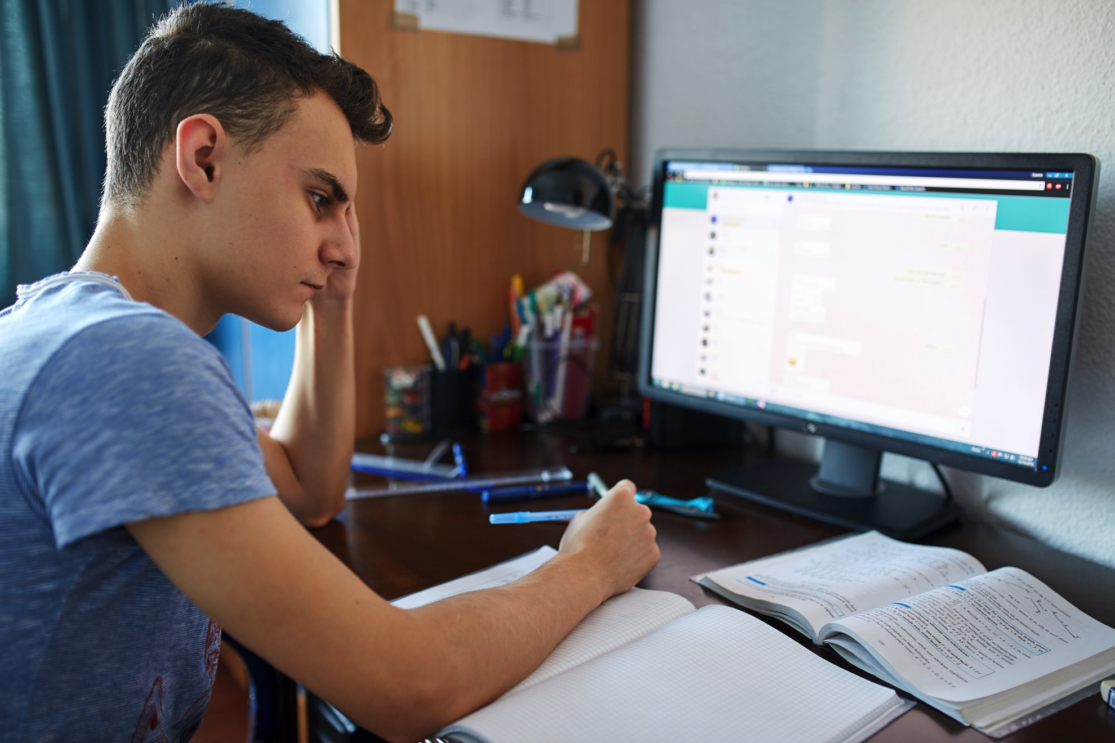
That is how long it will take them to begin the process of change.

Slide 30
Six-Step Action Plan
Step 1: Tell you child how you feel
Step 2: Establish the rule and expect success
Step 3: Active Supervision
Step 4: Consequences / Structure
Step 5: Consistency / Follow Through
Step6: What else should I do?

Slide 31
Review Activity 1.10
When children refuse to go to school, parents should take away _______________ on their “Child’s List” until they go to school.
When children return home from school, they can have the things on “Their List” only after they have completed their ________________.
Parents should tell their children how much they are loved _____________ .
Parents need three things to ensure their child does their homework.
a. A ___________homework assignment sheet.
b. Parents need to ____________their child’s home work when it is completed
c. Parents need to _______________ their “Child’s List” of activities until the home work is ___________.
everything / control / completed
finished / approve / everyday / homework

Slide 32
Review Activity 1.10
Most powerful ideas learned
from this class:

Slide 33
If you’re the only one who is frustrated with your child’s attendance and grades, you’re doing it wrong!

Slide 34
If your child is also frustrated, you’re doing it right!

Slide 35

Everything is Possible!

