Slide 1
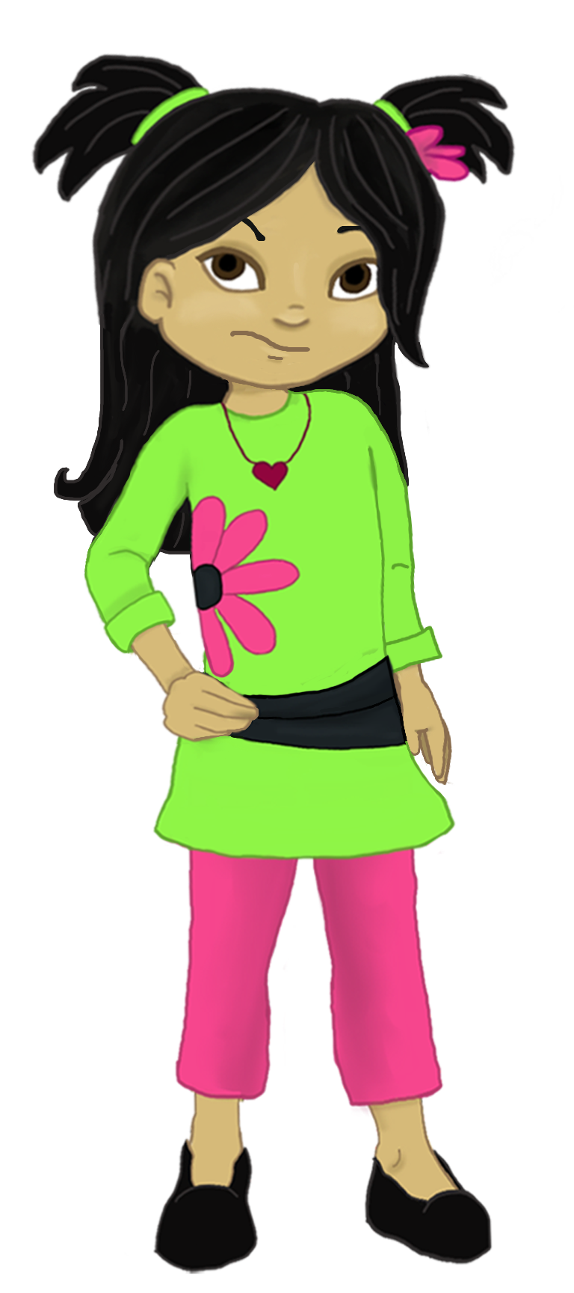
Welcome to:
Loving Solutions

Slide 2
Encouraging Positive Choices
3
UNIT
Getting More of What We Really Want For Our Children

Slide 3
We will be able to:
3
UNIT
Communicate our expectations, standards and values
Develop “I love” messages
Create Guiding Life Principles for our children
List the components of Active Listening

Slide 4
Elect Group Roles
3
UNIT
Group Facilitator
Group Recorder
Group Time Keeper
Nurturers / Cheerleaders
Don’t forget to change roles

Slide 5
Let’s Warm Up
3
UNIT
Did you use a Set Time Out?
What happened

Slide 6
Activity 3.1: Let’s Focus
3
UNIT
I can do whatever I want
Mom and dad are all talk

Slide 7
Our Expectations
3
UNIT
Must be communicated
Are usually met

Slide 8
Activity 3.2: Expectations
3
UNIT
Receive an education beyond high school
Live drug and alcohol free

Slide 9
Family Values and Standards
3
UNIT
Don’t use society as a yardstick for your family values and standards.

Slide 10
Activity 3.3: Values and Standards
3
UNIT

Slide 11
Guiding Life Principles
3
UNIT
Incorporate our standards and values
Communicate our expectations
Clarify our rules

Slide 12
Activity 3.4: Guiding Life Principles
3
UNIT
Guiding Life Principle:
This means:
Guiding Life Principle:
This means:
Guiding Life Principle:
This means:
Guiding Life Principle:
This means:
Guiding Life Principle:
This means:

Slide 13
Activity 3.5: Lists
3
UNIT
Homework
Lying

Slide 14
I love Messages:
3
UNIT
I love . . .
I see . . .
I feel . . .
Just Listen

Slide 15
Activity 3.6: Encouraging
3
UNIT
I love:
I see:
I feel:
Listen
I love:
I see:
I feel:
Listen
I love:
I see:
I feel:
Listen

Slide 16
Active Listening
3
UNIT
Is always empathic
Seeks complete understanding

Slide 17
Activity 3.7: Why we don’t
3
UNIT
Parent is too busy
Child’s issue seems ridiculous

Slide 18
Activity 3.8: Messages
3
UNIT

Slide 19
5 Steps to Active Listening
3
UNIT
Stop what you are doing
Look at your child
Listen to your child
Rephrase or repeat
Be empathic

Slide 20
Activity 3.9: Listening
3
UNIT

Slide 21
Involving Our Children
3
UNIT
There is a tendency to support what we helped create!

Slide 22
Negotiating with Children
3
UNIT
Cooperation brings compromise!

Slide 23
Activity 3.10: Compromise
3
UNIT
What does Joey want?
What do we prefer?
Possible compromises?
What would cause us to stop?
What can we live with?
What might cause us to withdraw?

Slide 24
Review Activity 3.11: Key Points
3
UNIT
1. Children are generally driven by _______________.
2. Parents should ______________ what they are doing when they listen to their children.
3. Parents should regularly _______________ their expectations to their children.
4. Children may need a ________________ ________________ Time Out, to motivate them to comply with a request or to complete a task they see as work.
5. Parents should use ___ Love ____________ to both encourage their children's positive behaviors as well as redirect negative choices.
communicate emotion I stop
Self Limiting messages

Slide 25
Most Powerful
3
UNIT

Slide 26
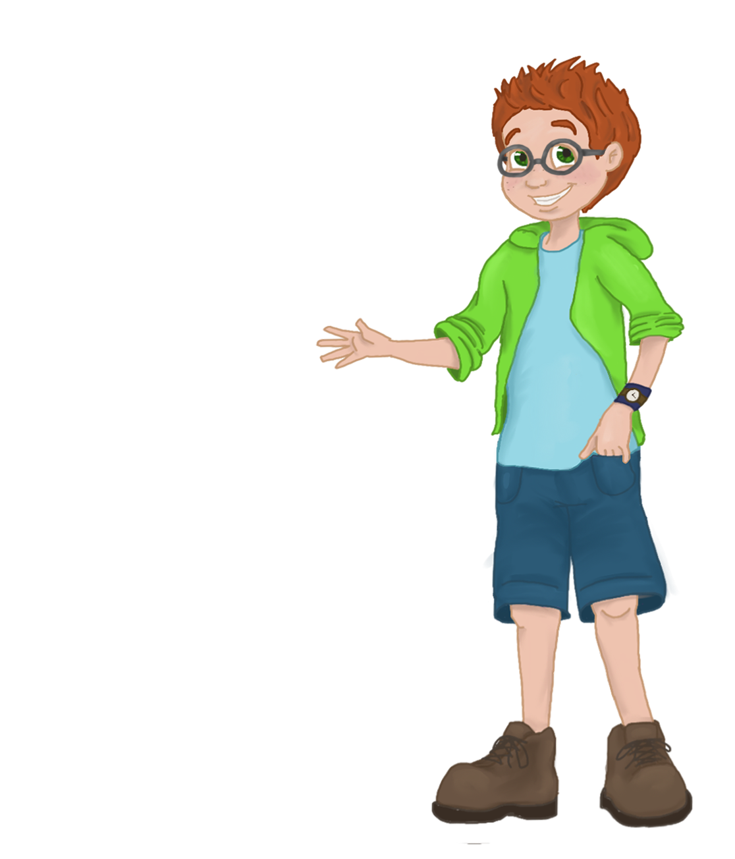
Redirecting Negative Choices
4
UNIT
List 5 tips for confronting unwanted behavior
Discuss why our words alone do not motivate many children to action
Explore the negative messages we send to our children when we are inconsistent

Slide 27
Words of Wisdom
3
UNIT
“Children often forget what we say, but they never forget how we make them feel.”

